Slide 1


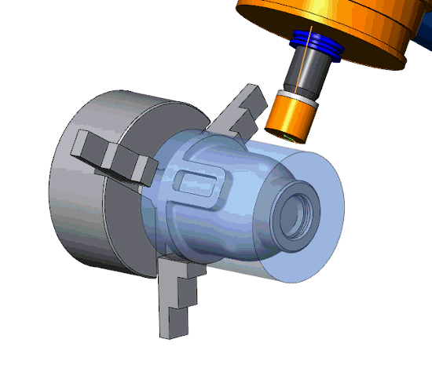
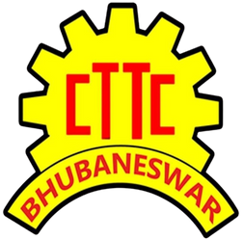


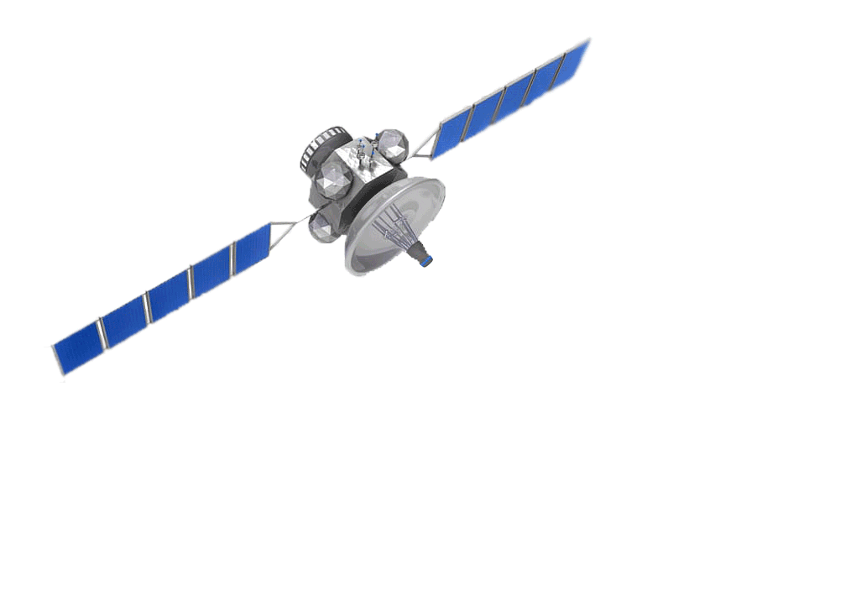

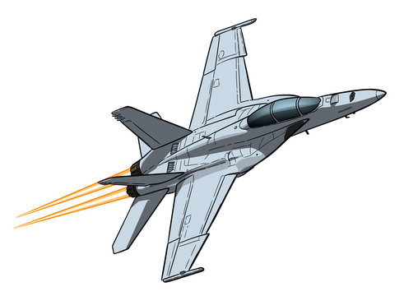

Central Tool Room & Training Centre
Bhubaneswar

Slide 2
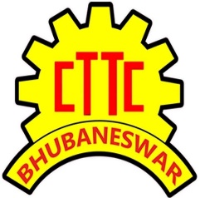


About CTTC Bhubaneswar
Success full Contribution for Moon Mission,
Mars Mission,
Ongoing Gaganyaan Mission
AS 9100, ISO 9001, 14001, 50001, OHSAS 18001 Certified
CTTC Bhubaneswar
Training
Production
Consultancy
R&D CELL
Skill Oriented Short Term & Long Term Courses for
Mechanical, Electrical, Electronics, Computer science, Civil & School Dropout Students
Manufacturing of Aerospace Components,
Satellite Components, Moulds, Press Tools, Jigs & Fixture, Machine Components & etc.
Intellectual Property Facilitation Centre (IPFC), Single Point Registration Scheme (SPRS), Scheme of Fund for Regeneration of Traditional Industries
(SFRUTI)
Manufacturing of Oxygen
Concentrator (PRANAVATY), Ambu bag Ventilator, Table top CNC Milling machine, Table top CNC Lathe machine, 3D printing machine, Hydra Pulper & etc.
30 000+ Students Foot fall Every Year
ISRO, HAL, ADA, DRDO, BHEL, RCI, GTRE, LPSC
Consultation Provided to 132+ MSME Units till date
40+ Projects Research and Developed by CTTC R&D Cell

Slide 3

CTTC Research & Development
The Research and Development (R&D) cell for MSMEs has been established at CTTC in the year 2014-15, sponsored by Development Commissioner (MSME), Ministry of MSME, Govt. of India. The Centre aims at helping MSMEs in promoting innovation. R&D for MSMEs is equipped with world class design lab and advance workshop with high accuracy machine R&D for MSMEs maintains confidentiality and non-disclosure of details submitted by members.

Slide 4

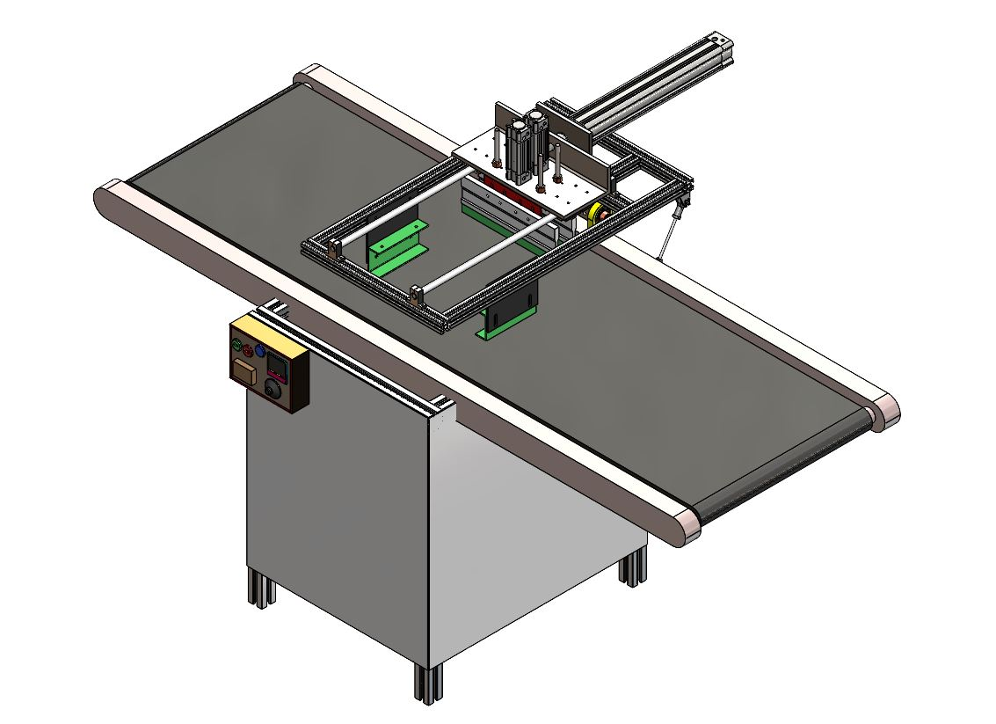
AUTOMATIC SCREEN PRINTING MACHINE
A screen printing machine is a device used to apply ink onto various substance, such as fabric, paper or plastic. It is commonly used in the printing industry for creating designs, patterns, logos, and artwork for different purposes such as textile printing, graphic design, advertising, signage, packaging, and electronics.
Screen printing machines have a wide range of uses across various industries and applications due to their versatility and ability to produce high-quality, durable prints.

Slide 5
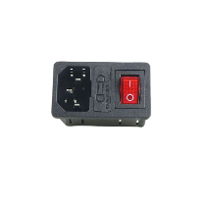
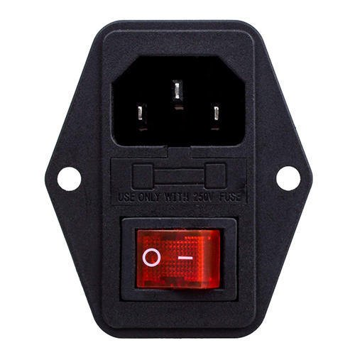
PNEUMATIC CYLINDER
(FOR PRINTING STATION FORWARD & BACKWARD)
PNEUMATIC CYLINDER
(FOR SQUEEGEE UP & DOWN)
PRINT HEAD
(SQUEEGEE)
PNEUMATIC CYLINDER
(FOR PRINTING UNIT UP & DOWN)
SCREEN FRAME CLAMP
FEEDING CONVEYOR BELT
CONTROL PANEL
POWER SOCKET & SWITCH

Slide 6

TECHNICAL SPECIFICATION
Model Name | Screen Printing Machine
Dimension | 2500X1500X1200 MM
Net Weight | 40 KG (APPROX.)
Length & Width Of Printing Area | 600 X 400 MM
Electrical Requirement | 220 v±22v/50 hz±1 HZ
Rating Current (A) | 7 AMP
Compressor Tank Capacity | 30 L
Motor Specification | 1HP SINGLE PHASE
Outer Body Material | Mild steel
Capacity | 900-1000 print per hour

Slide 7
Automatic screen printing machine can significantly increase production efficiency compared to manual screen printing methods. This machine allow for faster and more consistent printing, reducing production time and increasing output.
This machine is designed to ensure consistent and high-quality printing results. They provide precise control over various parameters, such as ink application and screen alignment, resulting in uniform and accurate prints.
Operators can easily adjust settings to accommodate different print sizes, types, and designs, allowing for the production of customized prints tailored to specific customer requirements.
Screen printing machine come with user-friendly interface and control, making them easy to set up and operate. This feature reduces the need for extensive training and minimizes the risk of errors during the printing process.
The precise control over the printing process ensures accurate and detailed prints, which is especially beneficial for intricate designs and patterns.
Screen printing machines can be scaled to meet the changing demands of the business. This machine can accommodate both small-scale and large-scale printing projects, making them suitable for businesses of various sizes.
ADVANTAGES

Slide 8
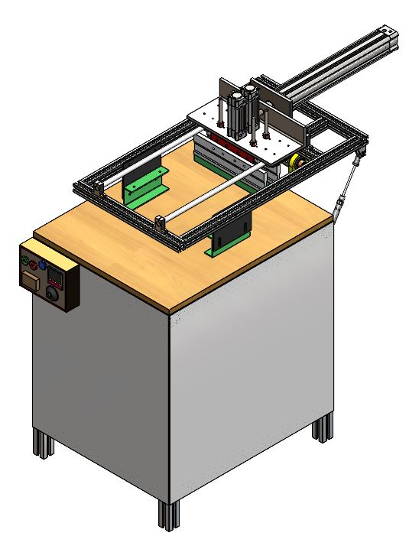
SEMI-AUTOMATIC SCREEN PRINTING MACHINE
A screen printing machine is a device used to apply ink onto various substance, such as fabric, paper or plastic. It is commonly used in the printing industry for creating designs, patterns, logos, and artwork for different purposes such as textile printing, graphic design, advertising, signage, packaging, and electronics.
Screen printing machines have a wide range of uses across various industries and applications due to their versatility and ability to produce high-quality, durable prints.

Slide 9
PNEUMATIC CYLINDER
(FOR SQUEEGEE UP & DOWN)
PNEUMATIC CYLINDER
(FOR PRINTING STATION FORWARD & BACKWARD)
PRINT HEAD
(SQUEEGEE)
PNEUMATIC CYLINDER
(FOR PRINTING UNIT UP & DOWN)
SCREEN FRAME CLAMP
CONTROL PANEL
POWER SOCKET & SWITCH

Slide 10
TECHNICAL SPECIFICATION
Model Name | Screen Printing Machine
Dimension | 1500X900X1200 MM
Net Weight | 40 KG (APPROX.)
Length & Width Of Printing Area | 600 X 400 MM
Electrical Requirement | 220 v±22v/50 hz±1 HZ
Rating Current (A) | 7 AMP
Compressor Tank Capacity | 30 L
Motor Specification | 1HP SINGLE PHASE
Outer Body Material | Mild steel
Capacity | 650-750 print per hour

Slide 11
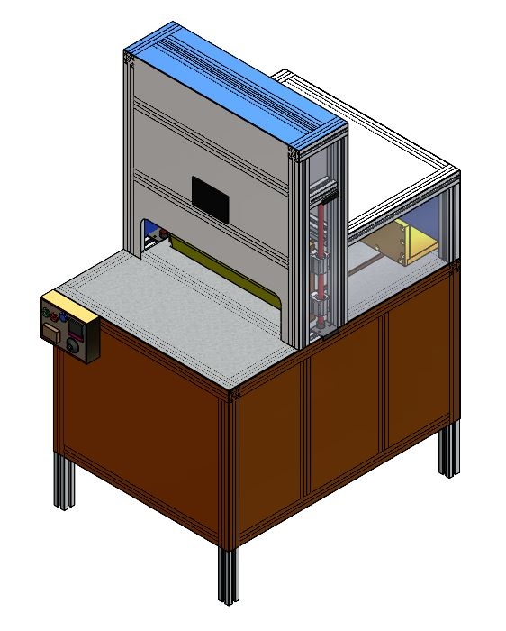
Paper Cutter Machine
A paper cutter machine is a piece of equipment used in various printing and document handling operations to precisely cut large quantities of paper or other materials into smaller, uniform sizes.
Paper cutter machine offer high precision and accuracy in cutting paper, cardstock, and other materials. This is essential for applications such as print finishing, bookbinding, and document processing.

Slide 12
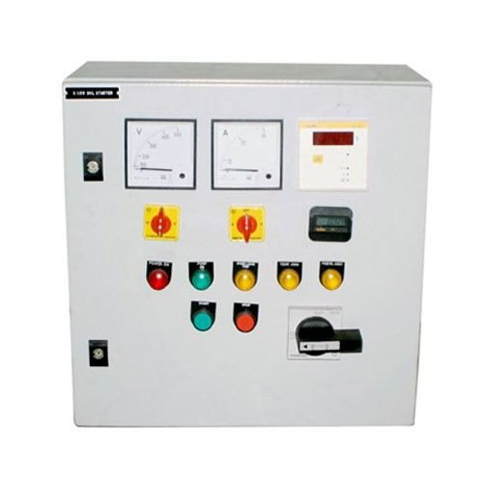
GRAPHICS DISPLAY
PAPER PUSHER
(FOR ADJUSTING THE PAPER SIZE)
PAPER CUTTER BLADE
PAPER CLAMP
PANNEL BOARD

Slide 13
TECHNICAL SPECIFICATION
Model Name | Paper Cutter Machine
Dimension | 1700X1200X1500 MM
Net Weight | 160 KG (APPROX.)
Electrical Requirement | 220 v±22v/50 hz±1 HZ
Power Consumption (W) | KW/HP 0.75/1.0
Rating Current (A) | 7 AMP
Motor Specification | 1HP SINGLE PHASE
Minimum Paper Cutting Size | 100X100 MM
Maximum Paper Cutting Size | 800X800 MM
Minimum Cutting Height | 10 MM
Maximum Cutting Height | 100 MM
Accuracy | 0.01 MM
Outer Body Material | Mild steel

Slide 14
The control panel allows the operator to set cutting parameters such as cutting length, stack height, and cutting speed. This model include a digital display for easy monitoring and adjustment of settings.
The clamp holds the paper stack in place during the cutting process to prevent slippage and ensure consistent cutting accuracy. It is often equipped with adjustable pressure settings to accommodate different types of paper materials.
To ensure the safety of the operator, This paper cutter machine is equipped with various safety features such as infrared barriers, safety locks, and emergency stop buttons.
This model allow users to store multiple cutting programs, making it easier to switch between different cutting tasks or materials without reconfiguring the machine each time.
The control panel on paper cutter machine is typically designed to be user-friendly, with intuitive interfaces that make it easy for operators to set cutting parameters.
ADVANTAGES

Slide 15
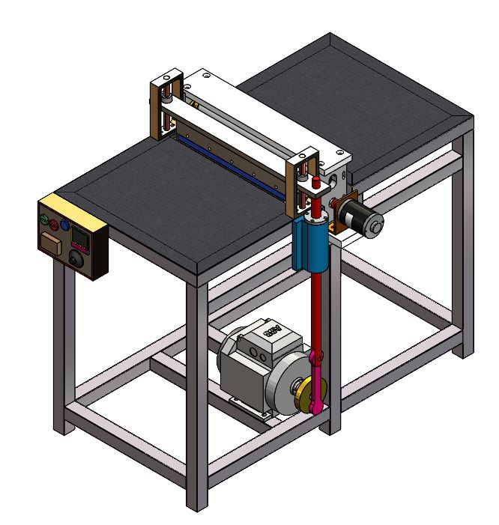
File Master
A file master machine is a type of equipment used for the production of files, folders, and other similar office supplies. These machines are designed to streamline the manufacturing process, improve efficiency, and ensure uniform quality in the production of various types of files and folders.
This machine is capable of handling various materials commonly used for file production, such as cardboard, paper, and other similar materials. This machine designed to ensure high precision and accuracy in cutting and shaping the materials, resulting in consistent and uniform file production.

Slide 16
ROLLING UNIT
GRAPHICS DISPLAY
PAPER SHAPING BLADE
PANNEL BOARD
MOTOR

Slide 17
TECHNICAL SPECIFICATION
Model Name | File Master Machine
Dimension | 1100X1000X900 MM
Maximum File Size | 800X800 MM
Electrical Requirement | 220 v±22v/50 hz±1 HZ
Power Consumption (W) | KW/HP 0.75/1.0
Rating Current (A) | 7 AMP
Motor Specification | 1HP SINGLE PHASE
Accuracy | 0.01 MM
Outer Body Material | Mild steel
Capacity | 900-1100 files per hour

Slide 18
This machine is equipped with cutting and creasing mechanisms that can accurately cut and crease the materials into the desired shapes and sizes for different types of files.
This machine typically require some manual input for material handling and adjustment but have automated functions for cutting, creasing, and other essential production processes.
This machine often come with user-friendly controls and interfaces that make it easy for operators to set up and monitor the production process.
Operators can adjust settings such as cutting length, folding dimensions, and other parameters to customize the production process according to specific file requirements.
To ensure operator safety, modern semi-automatic file-making machines may include safety features such as emergency stop buttons, safety guards, and other mechanisms.
Automated functions in this machine reduce the time required for manual cutting, creasing, and folding, leading to faster production cycles and quicker order fulfillment.
This machine can significantly increase the production efficiency compared to manual file-making processes, allowing businesses to meet larger order demands and deadlines more effectively.
ADVANTAGES

Slide 19
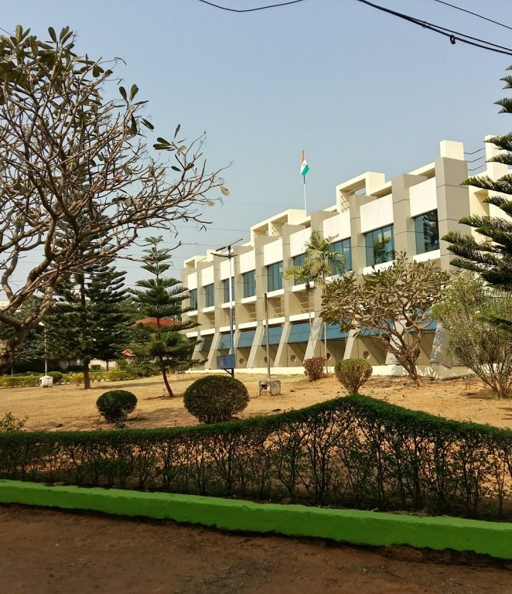

THANK YOU
WWW. cttc.gov.in
cttc@cttc.gov.in

